Slide 1
Announcements
Officer Internship Application due November 28th (Application on Discord and Email)
White Elephant Gift Exchange on December 3rd! 10$ gift limit
GDC meeting after this meeting

Slide 2
Paradigms and Gold Standards in UI Design
Presented by Jonah V.

Slide 3
Objectives
Identify great examples of UI
Determine what makes those examples great
Discuss what we can learn from each UI in the context of UX.
Notes:
First, I am going to identify a few examples of games that have great UI - we’ll call these our Gold Standards. With each game, I’m going to then determine which elements/traits, or paradigms, make that game’s UI successful. Last, after looking at each of our gold standards and paradigms, I’ll give a few recommendations on what you can learn from and how you can apply these examples.

Slide 4

Gold Standard:
Dead Space 2
(2011)

Slide 5
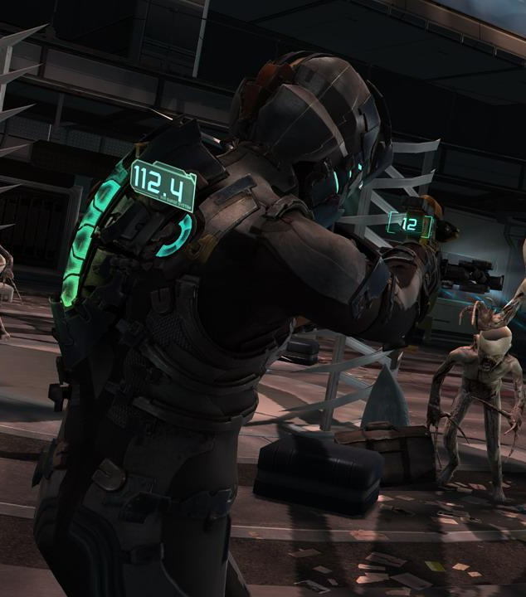
Dead Space 2: Summary
Survival horror / action game
Resident Evil 4, BioShock
Successor to Dead Space
Does everything better
Diegetic UI
UI is physically present
Adheres to game world’s lore
All UI metrics are physically displayed in-game
Notes:
Dead Space 2 is a survival horror action shooter, similar to other games such as Resident Evil 4, or Bioshock. As I’m sure you’ve guessed, the game is a successor to Dead Space (1), but in my opinion, it does everything that game does better, thus why I am analyzing it here. The reason I am using Dead Space 2 as one of our gold standards is that it is basically the poster child of great diegetic UIs. If you don’t know what a diegetic UI is, it is a user interface + head-up display (HUD) that is physically present within the game world, meaning it adheres to any rules/standards set within this world, and is basically tangible to any characters present in the game.

Slide 6
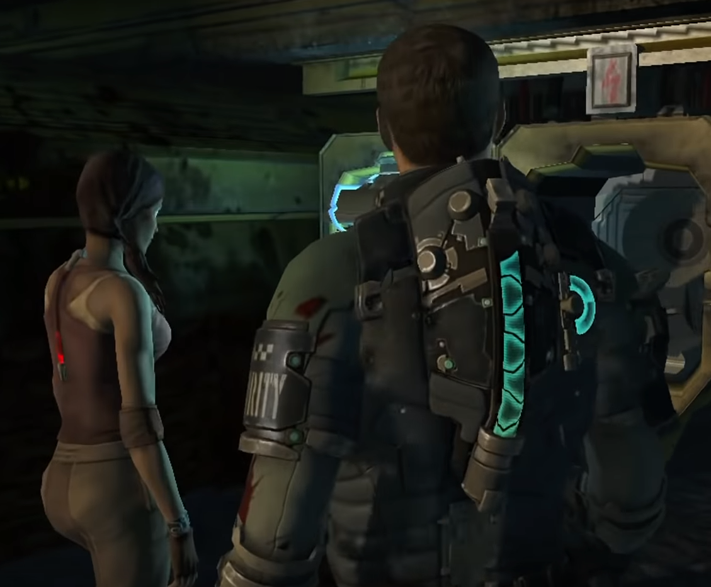
Dead Space 2: Paradigms
Health and Stasis Bars
Display tangible in-game stats directly on characters
Information is inaccessible in certain camera positions
PC (right), with a nearly full health bar, next to an NPC (left) that is at critical health.
Notes:
The first part of Dead Space 2’s UI I’ll be going over is the way in which the health and stasis metrics are displayed in the game. These statistics are consistently important to the player, so the prominence of their appearance in the game world should naturally take a similar precedence. By being placed on the PC’s (player character’s) back, these statistics can be viewed at almost all times - the only times they can’t be are when the camera is not facing the player character’s back, which is generally a rare occurrence.

Slide 7
Dead Space 2: Paradigms
Weapons
Physical “reticle” and ammunition counter
Shows exactly how shots connect since they can be divided
More accurate and immersive
Taking aim reveals your ammunition count and where your shots will land.
Notes:
The next UI paradigm is the set of elements that make up the game’s weapon handling. As this is an action-horror game, the player’s experience with weapons should be often and tense, but still very accessible. With Dead Space 2’s weapons, the player can obtain information exactly when they need it by simply aiming their weapon. This will show the weapon’s ammunition count, as well as the targeting reticule(s). With this system, the player obtains information exactly when they need it - when the information is not needed, it’s not shown. A solution like this can be incredibly tricky to work in to a game, but with a diegetic UI, you can deliver information to the user at specific times, rather than all the time, to reduce clutter.

Slide 8
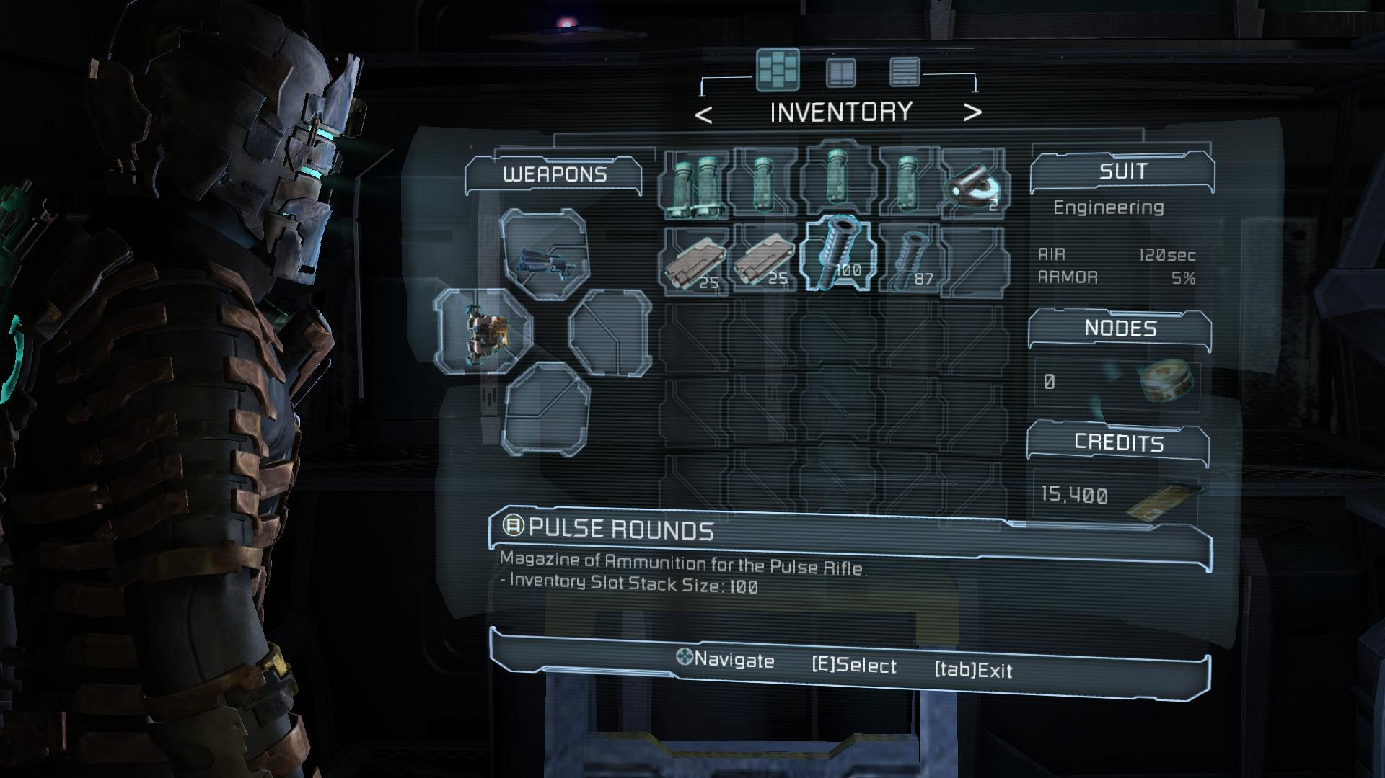
Dead Space 2: Paradigms
RIG / Inventory
Contains all other important items and stats
Still acknowledged tangibly in the game world
Navigated using D-Pad or arrow keys
The PC’s head tracks player selections in the inventory and journal. This menu hologram physically illuminates its surroundings.
Notes:
The last paradigm I’m going to look at with Dead Space is the RIG, or the Resource Integration Gear, which is pretty much what it sounds like. This is a multi-purpose menu with simple navigation that contains all important information that isn’t immediately displayed the normal gameplay HUD. This includes the player’s inventory for collected items and currency, the mission status for current tasks, and the database for found notes and audio logs. Like everything else, this menu is displayed within the game world. This menu is navigated with a pretty simple layout containing tabs, grids, and lists. However, the control scheme for this menu doesn’t exactly afford the same exact simplicity. Since the menu is displayed in real-time, the player can move their character and the camera while it is open, so the menu itself has its own individual set of controls. This takes some control away from the player’s physical movement, thus forcing the RIG to be used either outside of combat, or sparingly within. This can cause some anxiety in the player, which is important to manage in a horror setting.

Slide 9
Dead Space 2: Applications
Developer and player share control over accessing information
Lends itself well to survival-horror
Believable and tangible
Immersive
Mostly self-explanatory
Notes:
Because of how information is displayed in Dead Space 2, the player and the developer share control over accessing it. For instance, it’s the player’s choice to rotate the camera in order to see what their current health is, but sometimes that control can be taken away during QTE’s and cutscenes to cause distress, thus lending itself well to the survival-horror genre. Since 100% of the UI is represented within the game world, and it all follows specific rules of the technology within said world, the UI is far more “believable,” which is not a word you’d usually use to describe a user interface. I know the word “immersion” gets thrown around a lot when it comes to games, but Dead Space 2 is a truly immersive game because of how tightly integrated the UI is with the game as a whole. Immersion is important in a game, so think about how the use of a diegetic UI might help improve your game experience. Additionally, and perhaps more importantly, make sure to look closely at how and when different game information is displayed, and how control (or lack of control) over accessing information can affect the user experience.

Slide 10

Gold Standard:
Overwatch
(2016)

Slide 11
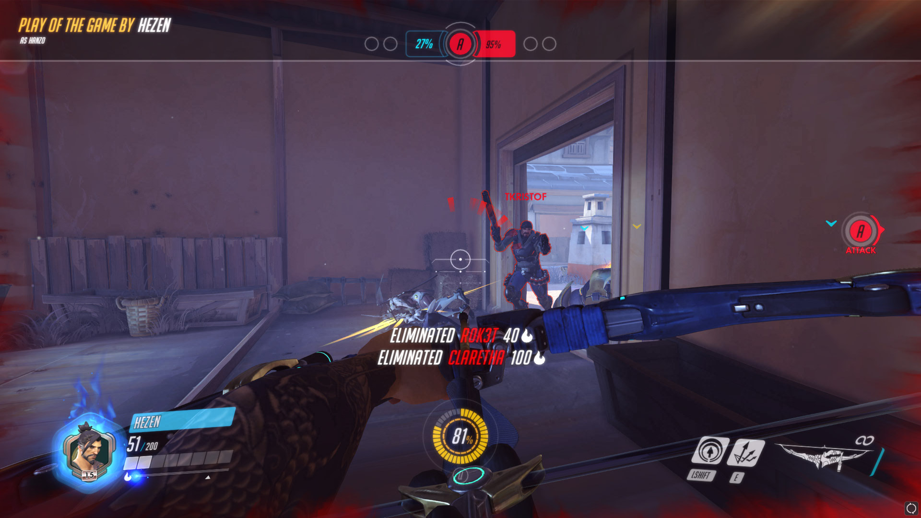
Overwatch: Summary
Class-based FPS
Team Fortress 2, Paladins
Highly polished UI
Reactive
Subtle animations
High-tech & low-key
Every piece of Overwatch’s UI is both meaningful and visually dynamic - even the main menu has multiple backgrounds.
Notes:
Overwatch is a class-based first person shooter (or hero shooter), similar to other games like Team Fortress 2 or Paladins. Overwatch is the perfect example of a streamlined, polished, and purpose-built user interface, so with this game, I’ll be identifying the most important parts of its UI that contribute to the game’s general polish.

Slide 12
Overwatch: Paradigms
https://giant.gfycat.com/SpryMiserlyHammerheadshark.webm
Transitions
All screens have smooth transitions between each other
Physically “maps out” the UI
Drastic changes in game states are less jarring
<gif not present in slideshow because google slides blows>
Notes:
Between every “screen” in Overwatch, such as from hero selection to gameplay, or from gameplay to the end leaderboard, or from anywhere on the main menu to anywhere else, there is some sort of transition to help the player understand “where” they are going next. These transitions can be anything, from a fade to black, to a physical change in 3D location accompanied with different interface animations. There are various transitions throughout all of the different screens in Overwatch, and these are all designed to “map out” the UI itself as a set of different game states. Oftentimes in games, a player might leave a match and return to the main menu, or a match might end and the player expects to see how they performed in that match. Without any sort of animation, these changes in game states can be incredibly jarring, but by introducing even the most simple of transitions between screens, it can help a player’s sense of “interface direction” by just that much.

Slide 13
Overwatch: Paradigms
UI Effects
Glowing & aberration
HUD shake
Use of color to signify changes in status
HUD shakes whenever player jumps and lands
Notes:
Almost every first person game has some sort of HUD (or head-up display), and Overwatch is no exception. In order to make it more visually appealing however, Overwatch’s first person UI has a number of effects that help the player understand their current status, as well as simply making it more dynamic overall. While these are not all of the effects that are present within Overwatch’s HUD, I think that they are the most artistically simple to implement with respect to just how much they assist in further polishing the UI. These effects include glowing and chromatic aberration around certain elements, HUD shake under certain movement conditions, and using flashes of color, or just solid color, to represent changes in things like the player’s current health, or the progress of building up their hero’s ultimate ability. Like I said, there are many more effects and techniques at play here, but these are some of the most fundamental ones that make Overwatch’s HUD so great.

Slide 14
Overwatch: Paradigms
Unique/Dynamic Elements
Appear with specific game modes or heroes
Reminder of combat abilities and objectives
Can help player understand maps, game modes, and heroes better
Unique HUD elements make an appearance with the use of Doomfist’s abilities.
Notes:
This one is a bit more tricky to explain, but it essentially boils down to that certain elements in the UI will only show up at certain times. It’s not the same thing as information being accessed when it’s needed as I discussed earlier, but rather, different elements will show up depending on the game context. For instance, when playing Escort mode, where the objective moves on a linear path across the map, there will be an indicator constantly present on the screen that shows the status of the objective with respect to where it is located on the map. Another example is the way that hero abilities are displayed beneath the crosshair for certain characters such as Tracer or Doomfist. Overall, these “unique” UI elements are implemented primarily to help the player understand what’s actually going on in the game (as all good UIs should), but in addition, they generally also help quite a bit with polish by differentiating different states of play with new pieces of UI.

Slide 15
Overwatch: Applications
Overwatch is very polished
Don’t expect to ever reach this level
Pick and choose the little things
Don’t be afraid to experiment
Notes:
So when it comes to Overwatch’s UI, you should realize that you’ll probably never have a UI that’s as clean and smooth. But it’s important to also realize that adding small details like those seen throughout this UI can go a very long way in making your UI feel so much better. And, just make sure to experiment and mess around with different ideas for your UI until you have something that looks and feels great. Don’t just settle for the necessities or what works on the most fundamental level - you might just find something that looks and functions far better.

Slide 16

Gold Standard:
Mirror’s Edge Series
(2008-2016)

Slide 17
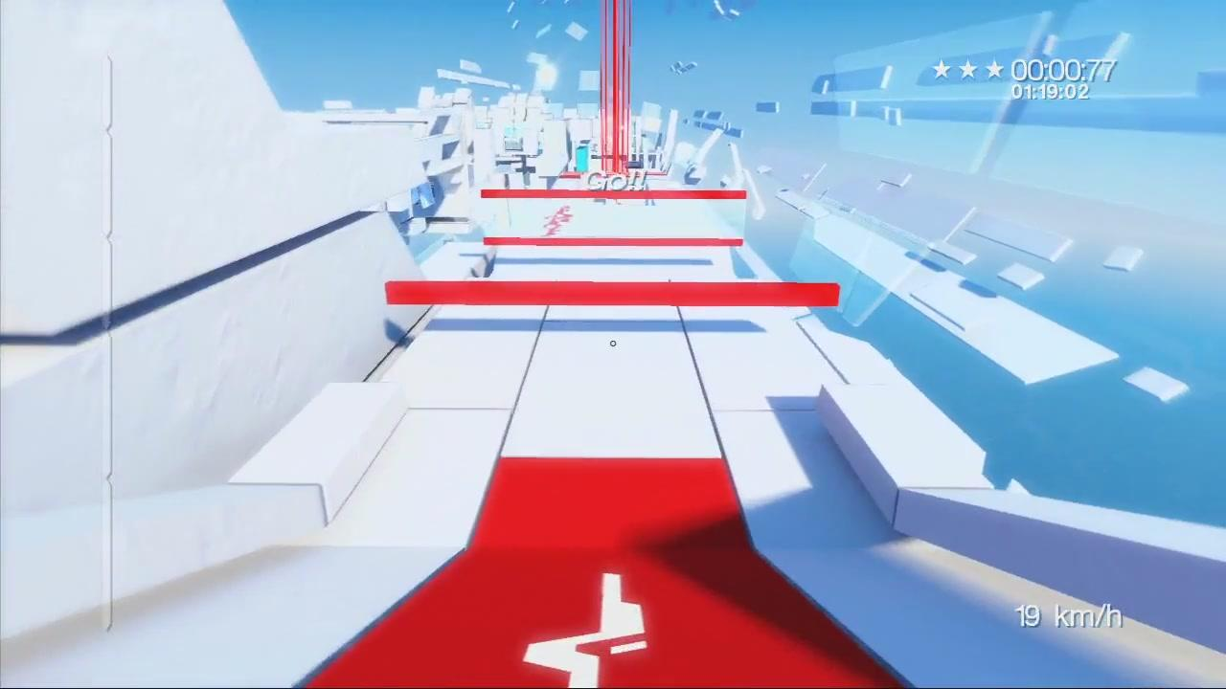
Mirror’s Edge Series: Summary
First person parkour
Not many games like it
Extremely minimal UI
Very few HUD elements
Runner’s vision as spacial UI
Simple colors
Each of the red elements in the environment is a cue to the player to continue on that path - this is a “spatial UI” known as Runner’s Vision.
Notes:
Mirror’s Edge and Mirror’s Edge Catalyst are first person parkour games where the player is challenged to navigate various platforming environments, usually under time constraints. There aren’t very many games like it, but it does a lot of things well, so everything it does should be taken as an example of the “genre” as a whole. The Mirror’s Edge series is known well for its extremely minimal UI, especially in the first game, where there’s only 1 persistent piece of HUD throughout the story mode. The games feature a mechanic known as Runner’s Vision, which serves as a spatial UI to guide the player, reduce HUD clutter, and just help with the game’s style and aesthetics. Overall, the games themselves feature a simple but stark color palette, and this goes for the UI elements as well, further helping keep things minimalistic.

Slide 18
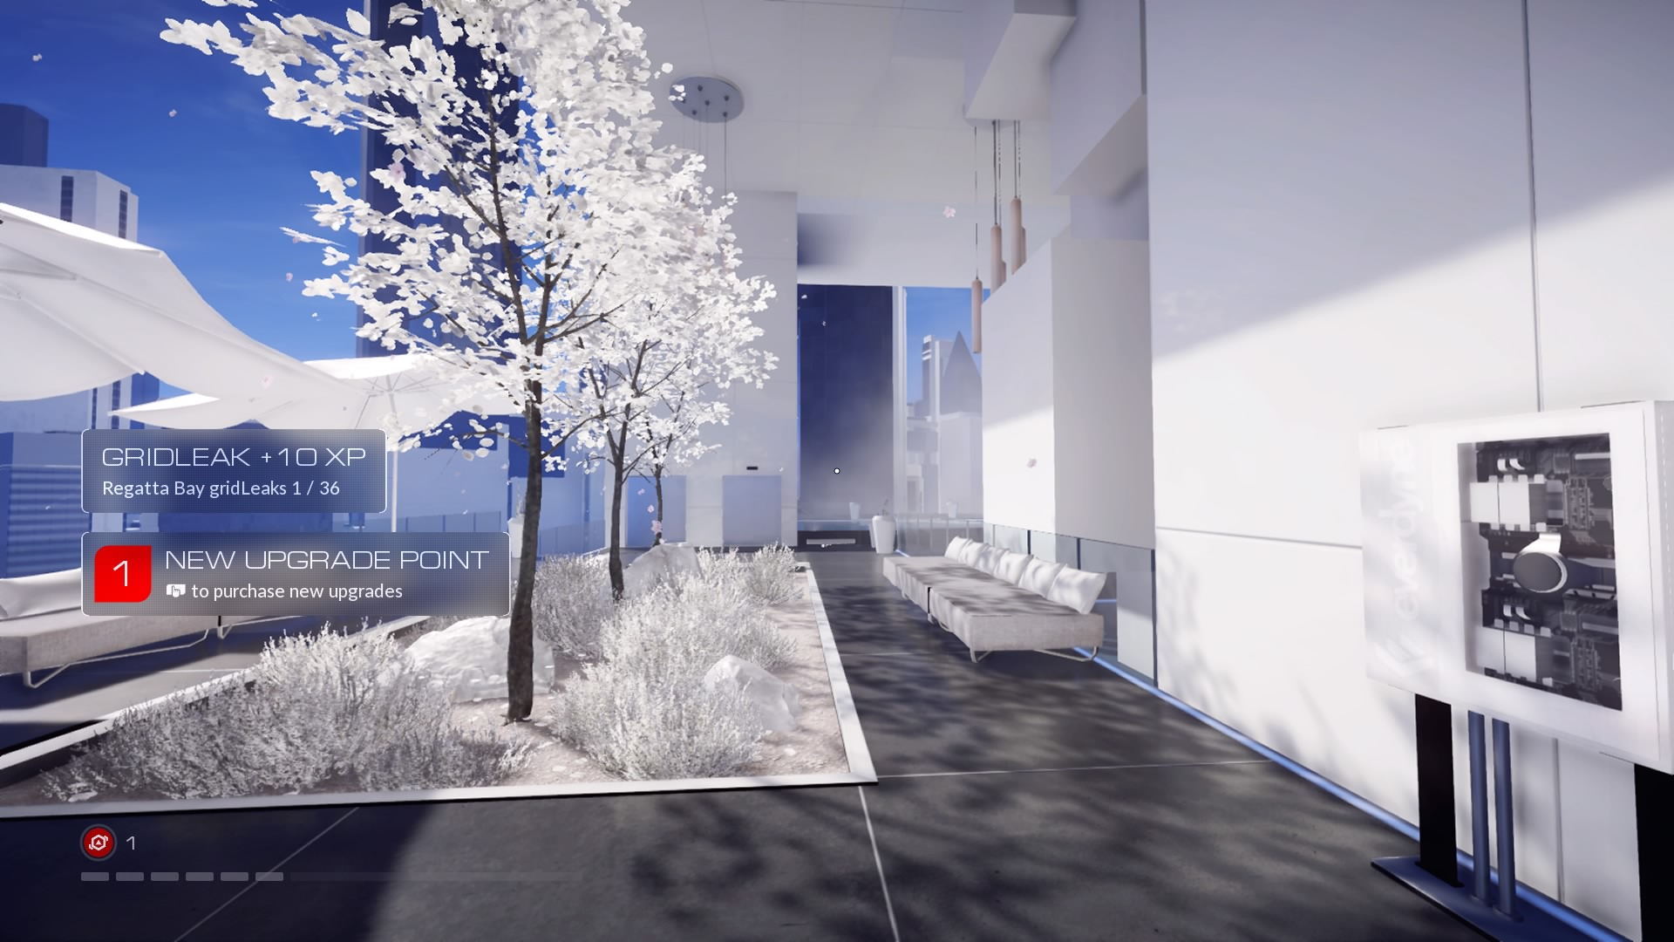
Mirror’s Edge Series: Paradigms
Sparse HUD
1 - 2 persistent elements, with occasional contextual pop-ups
Screen space FX as a sort of HUD
Gameplay of Mirror’s Edge Catalyst, featuring the persistent HUD elements on the bottom left, with contextual notifications present
Notes:
Both games only have about 1 or 2 HUD elements present on the screen during normal gameplay - that is, when the player is not in a race/timed mode. In the first game, the only HUD element is a dot that represents whether your slow-mo ability is available. The first game also has some neat screen effects that represent when your slo-mo ability has charged and when you’ve hit top speed - these aren’t exactly traditional UI elements, but they do help the player understand their current status in an abstract but still understandable and simple way. In the second game, the HUD includes your health and “focus” meter that represents when you hit top speed, as well as the amount of “disruptor” charges you have for use in combat. The games keep the UI elements present on screen to an absolute minimum, and only have a few other things that show up depending on situations such as combat or when you have certain objectives.

Slide 19
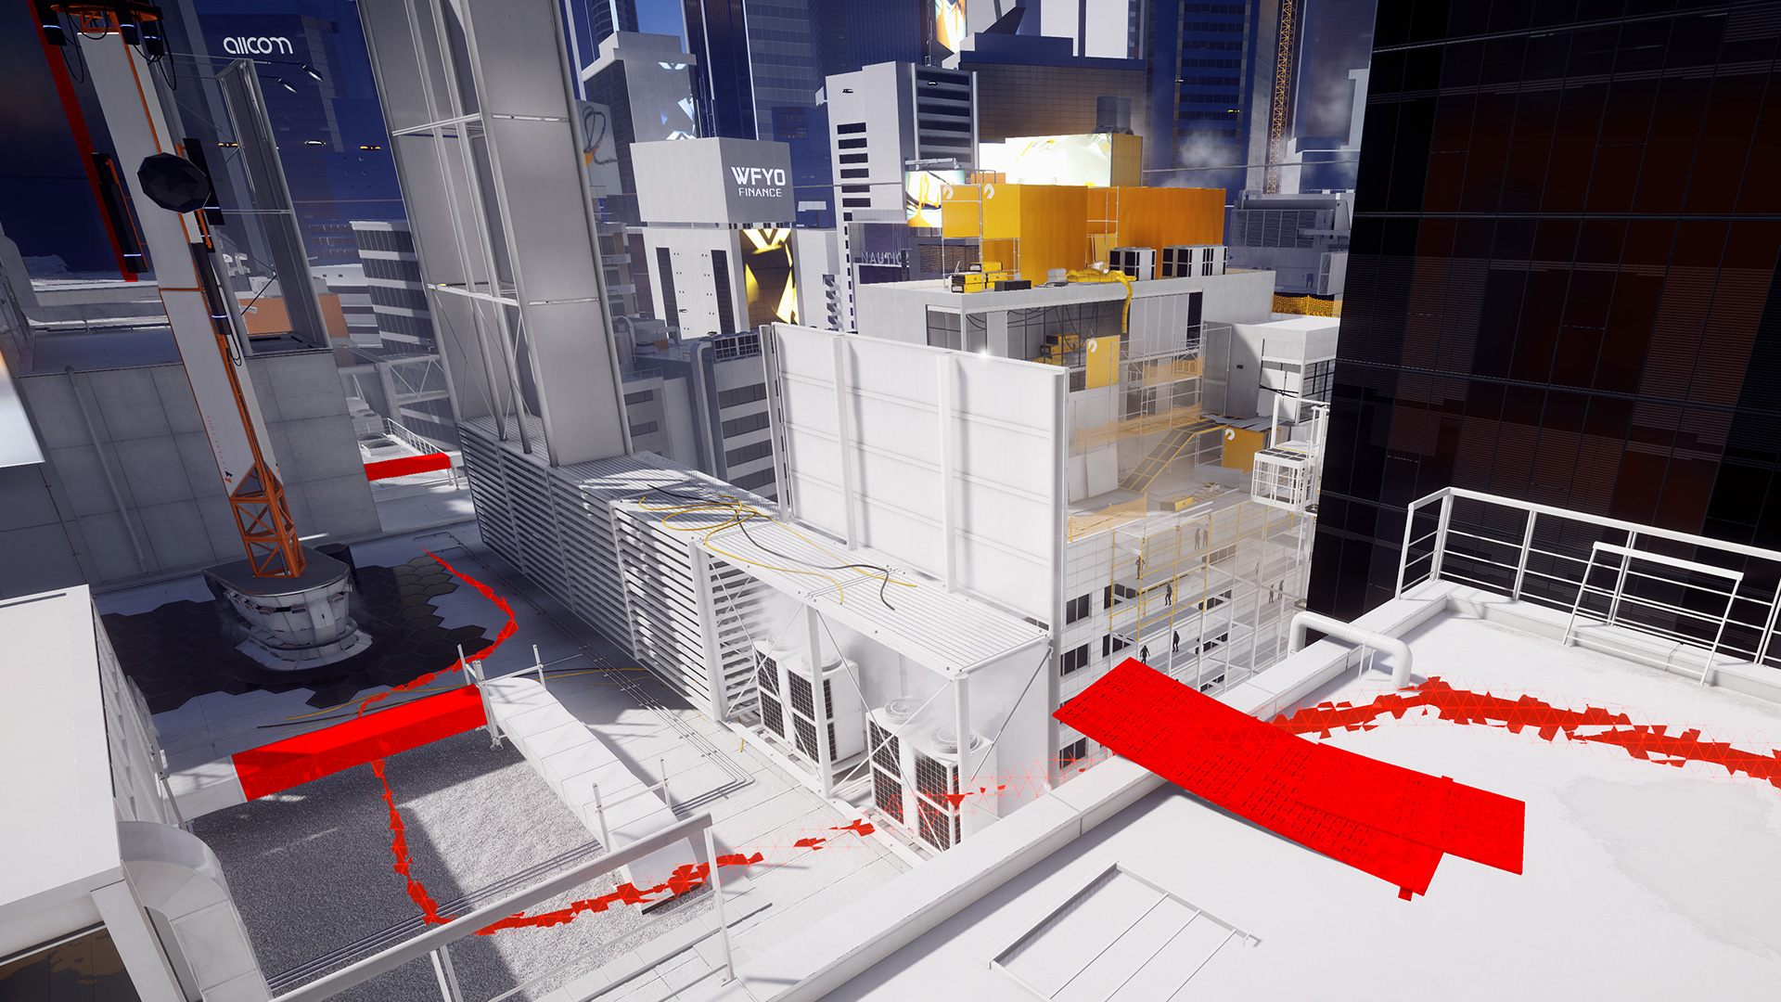
Mirror’s Edge Series: Paradigms
Runner’s Vision
A spatial UI seen by the player, but not the people in-game
Mini “checkpoints” that allow for experimentation and discovery in-between
Better done in the 1st game
Runner’s vision highlights elements in the environment to traverse with, with an optional snaky path to show the way.
Notes:
The Mirror’s Edge games feature a previously mentioned mechanic called Runner’s Vision, wherein objects throughout the world that can be used for traversal are highlighted in order to guide the player to the end goal. While this is not exactly a traditional UI, it still encompasses traits of spatial UIs - which represent information to the player in the 3D world, but aren’t necessarily seen by the people inhabiting the game world. This is explained away as the “runners” in the game having an intuition for how to navigate the world. The second game in the series goes further and introduces a snake-like figure that guides the player along, as well as far more frequent objects highlighted by runner’s vision, but I prefer the first game’s minimalism, with the runner’s vision objects standing more as gates between platforming puzzles rather than guiding the player through the entire navigation puzzle mindlessly.

Slide 20
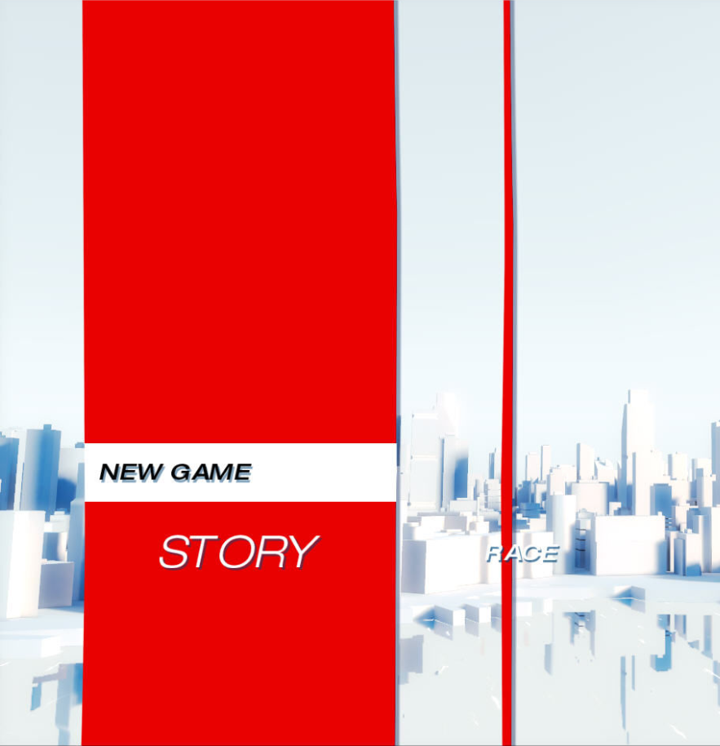
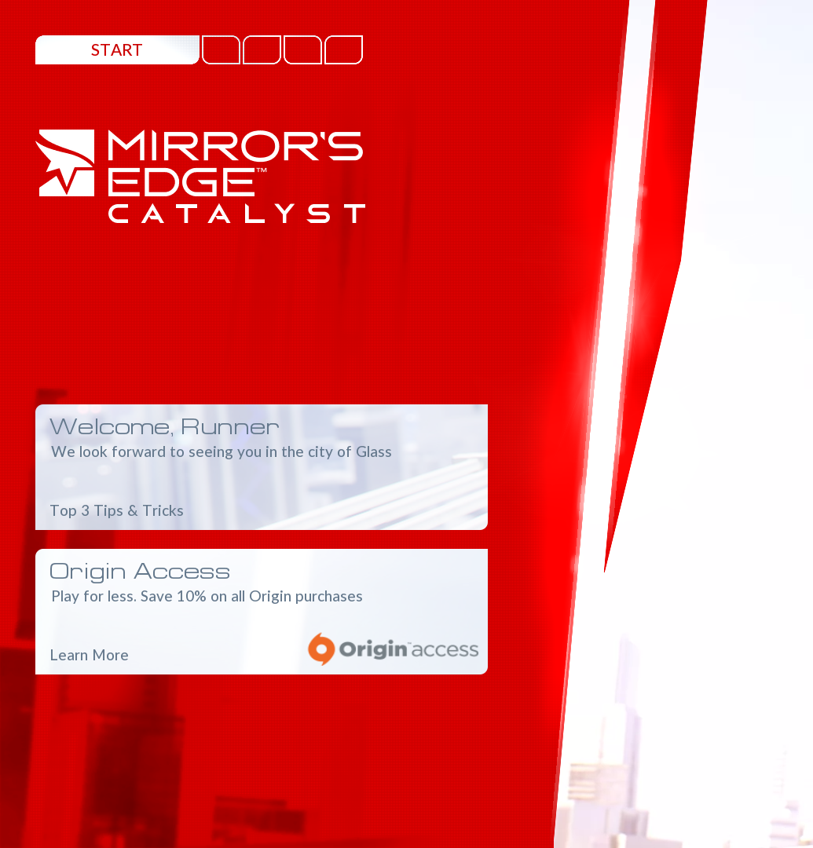
Mirror’s Edge Series: Paradigms
Simple Menus
Have as little information as possible
Plain shapes, colors, and layouts (less so in the sequel)
Designed to get the player back to the game
Part of the main menu of Mirror’s Edge (left) and Mirror’s Edge Catalyst (right)
Notes:
This part kind of explains itself, but basically, the Mirror’s Edge games keep the menus simple. Though the second game has an entire open world map and unlockable skills, the menus are still generally streamlined throughout both games. They are designed to contain as little information as possible, and have fairly simple shapes and colors present throughout. Though some of this is unheard of in the world of user interfaces, the simple menus in these games promote minimalism so as to reduce the time the player is even interacting with them. Having minimal UI, as we’ve discovered with some elements of Dead Space 2, helps keep the player playing the game, rather than fiddling with menus. Like Dead Space 2, this helps quit a bit with immersion.

Slide 21
Mirror’s Edge Series: Applications
Minimal UI only works for certain games
Limits what your game can do
Mixture of representations reduces clutter
Helps limit aesthetics to gameplay
Notes:
Mirror’s Edge’s UI works because Mirror’s Edge is kind of a simple game about doing a select few things. Minimal UIs aren’t going to work with every game, as they reduce the number of ways your player can interact with certain parts of your game. Regardless, if you think a minimal UI might work for your game, make sure to check out how other games have managed reducing clutter in their UI. One of the best ways Mirror’s Edge reduces clutter is by mixing up its representations of information, essentially dividing up where and how information is displayed instead of keeping it all in one place. Additionally, one of the biggest benefits of having a minimal UI outside of maintaining a precedent is that it simply reduces your own workload. Minimizing UI elements allows you to focus on perfecting your gameplay aesthetics above all else, rather than spending so much time figuring out what works and what looks good with things that aren’t even your actual game.

Slide 22
Conclusion
Look at other game UIs
Don’t take elements out of context
Tweak things until it looks and feels right
Great UI speaks for itself
Notes:
In general, there’s almost never a better way to figure out what works in UI than by looking at how others do it. If you’re going for a certain experience, find games that do it similarly, and figure out exactly how the interface contributes to that experience. Don’t lift UI elements out of a game without first understanding what makes them work in that game, and what they provide to the end user experience. Additionally, make sure you experiment with and change around whatever you implement. UI takes time. No matter what you’re doing, it will take time to make it perfect - but once you have something that works well, you’ll know.

Slide 23
Further Reading (Gamasutra Articles)
General UI design stuff:
The Complexity of UI Design (Josh Bycer)
Different types of UI (Diegetic vs non-diegetic):
Game UI Discoveries: What Players Want (Marcus Andrews)

Slide 24
Further Reading (Games)
Alien: Isolation
Borderlands (series)
Far Cry 2
League of Legends
Persona 5
Portal 2
Team Fortress 2
World of Warcraft

Slide 25
Thanks!

